Slide 1
Web design
Programming
App development
Video game design
Animation
Cybersecurity
Research
Software development
Data science
Notes:
So we’ve done a bit of programming of our own but …what’s the point of it? What can learning to program actually lead to?

Slide 2
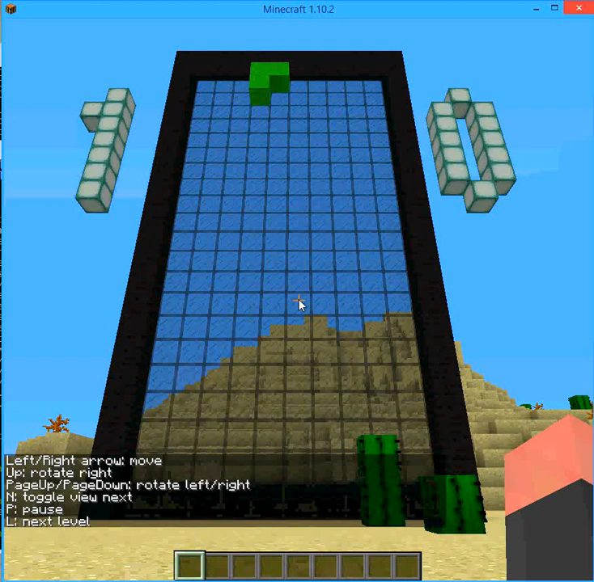
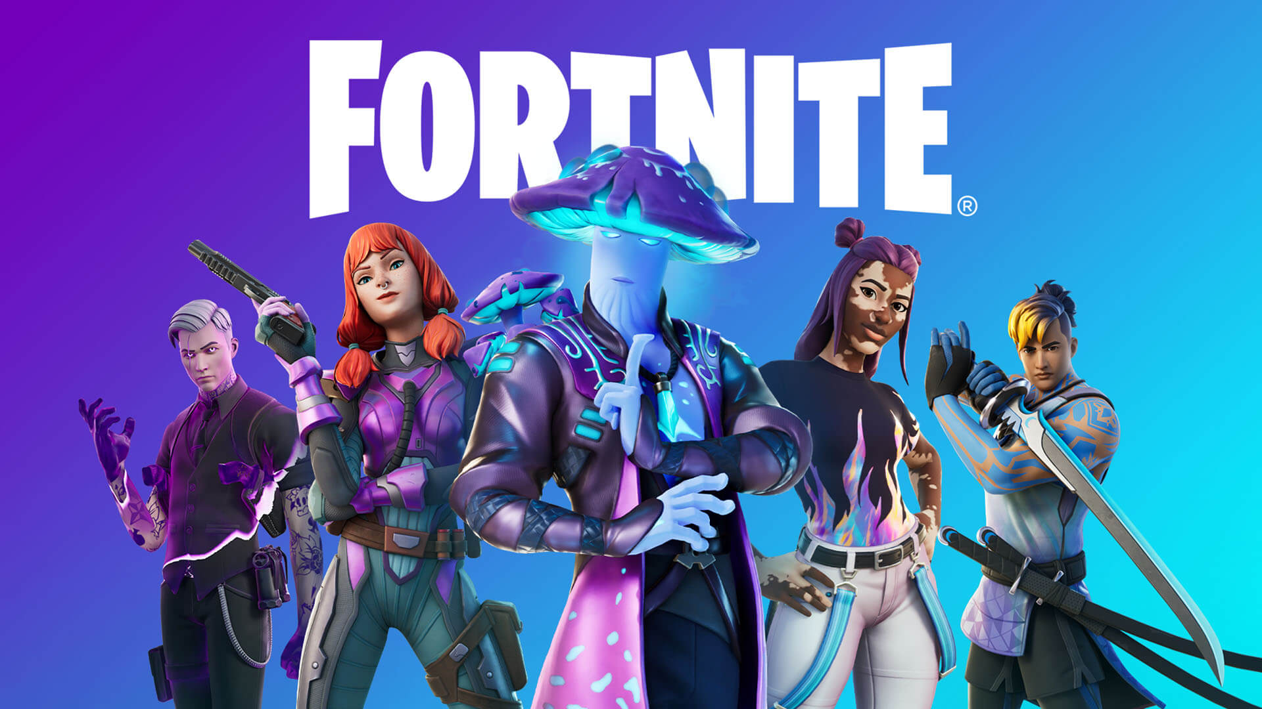





Game development/app development
Notes:
https://www.mobileappdaily.com/app-development-programming-languages

Slide 3


Cyber security
Notes:
https://www.bbc.co.uk/news/business-64244121
https://www.bbc.co.uk/news/technology-40297493

Slide 4

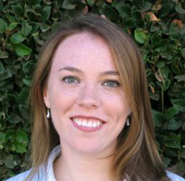
Animation
Kelly Ward Hammel: Software Engineer at Walt Disney Animation
Notes:
https://womeninanimation.org/wia-spotlight-academy-tech-award-winners/

Slide 5

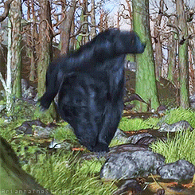

Animation

Slide 6
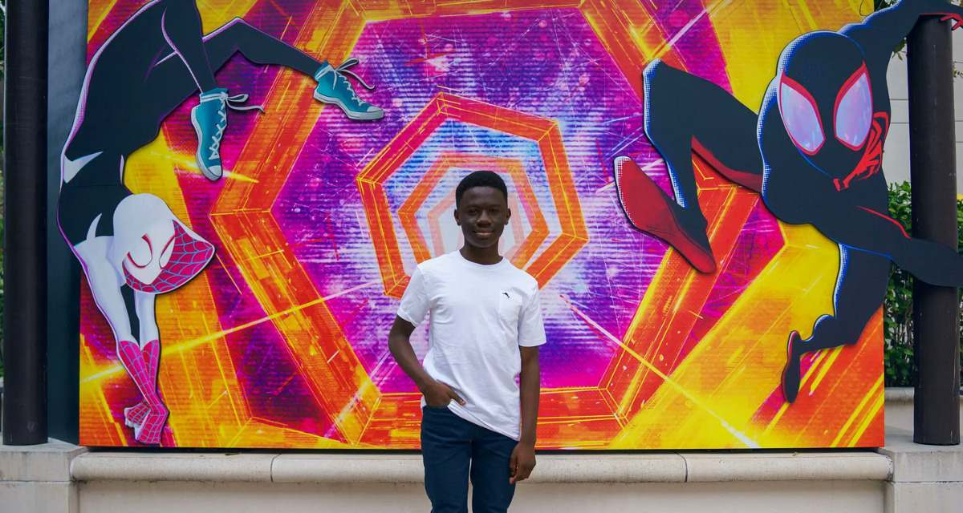
Animation
Notes:
Preston Mutanga

Slide 7
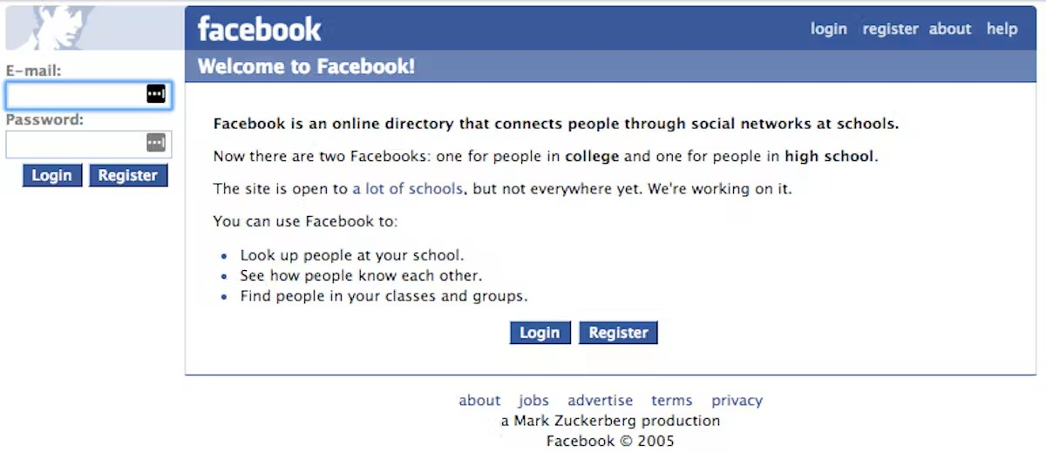
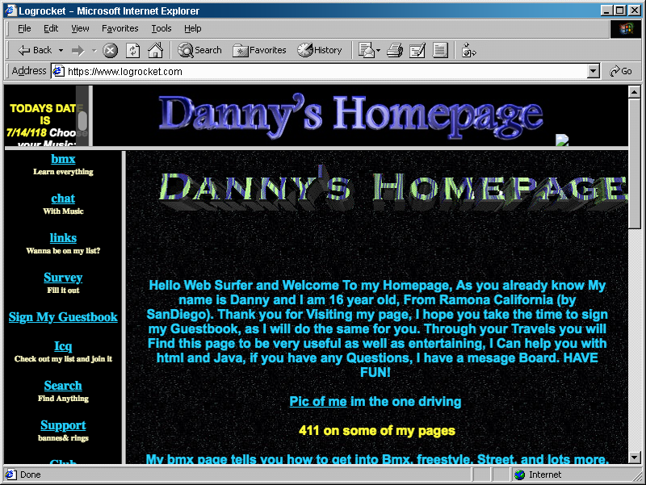


Web development
Notes:
This was in a period which prioritised maximal design. Nowadays, web design tends to prioritise efficient minimalist designs that function well on mobile and PC.
https://theconversation.com/a-nostalgic-journey-through-the-evolution-of-web-design-98626
https://devmountain.com/blog/all-about-web-designers-description-salaries-and-outlook/

Slide 8


Web development
Notes:
This was in a period which prioritised maximal design. Nowadays, web design tends to prioritise efficient minimalist designs that function well on mobile and PC.
https://theconversation.com/a-nostalgic-journey-through-the-evolution-of-web-design-98626
https://devmountain.com/blog/all-about-web-designers-description-salaries-and-outlook/

Slide 9
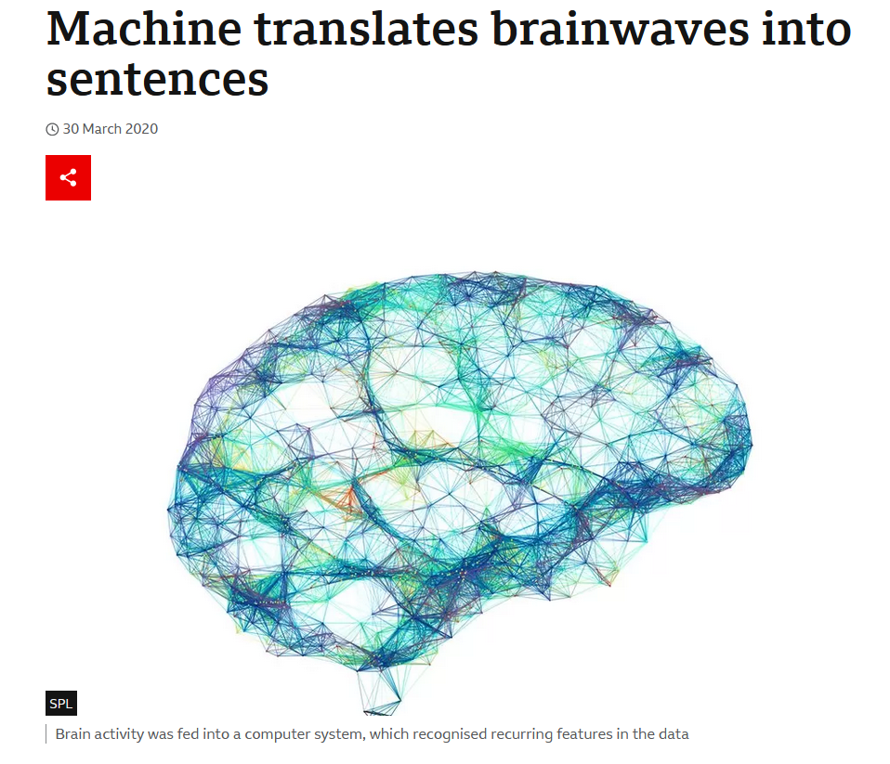
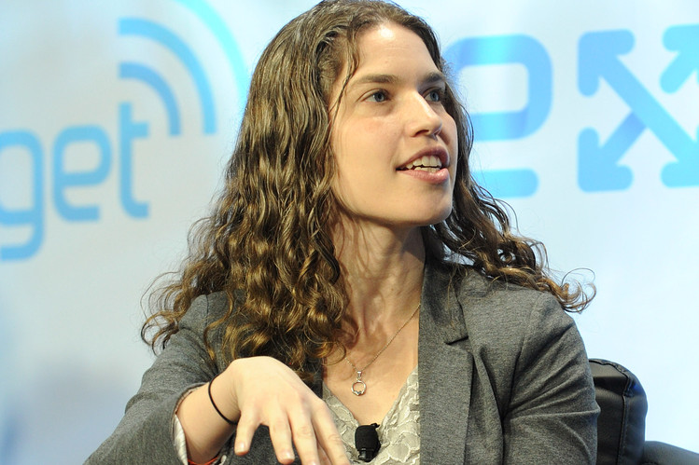
Data science
Hilary Mason
https://www.youtube.com/watch?v=5q87K1WaoFI&t

Slide 10
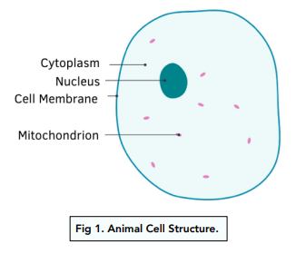
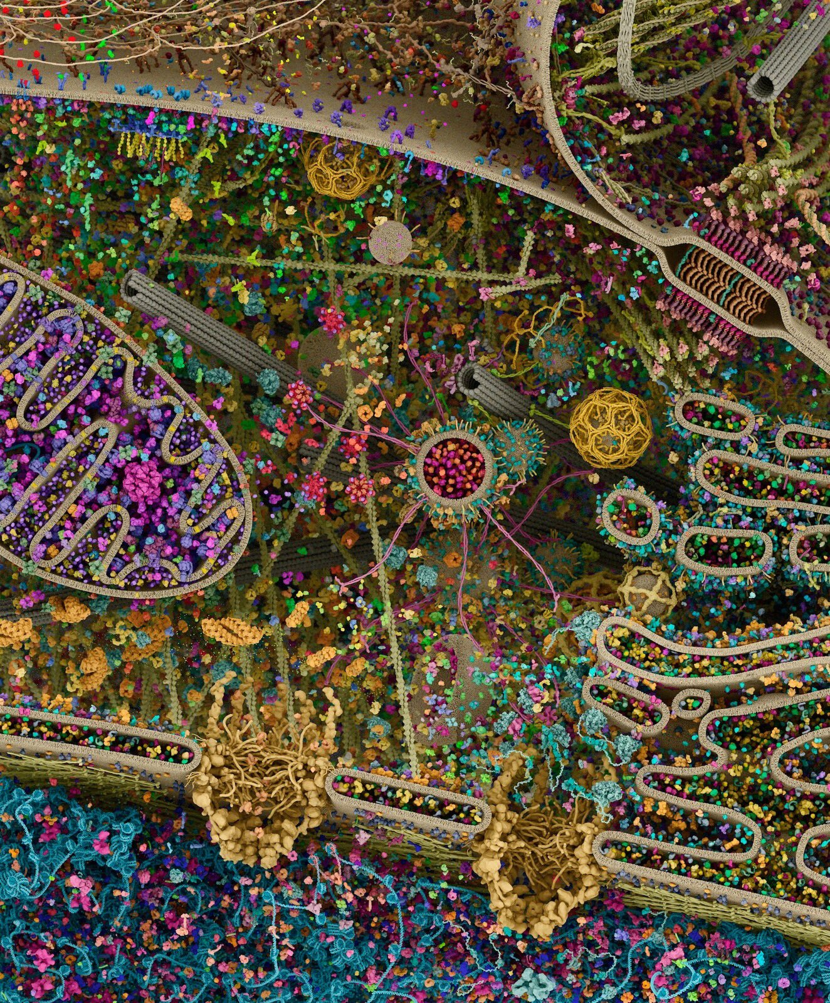
Research - computational biology

Slide 11
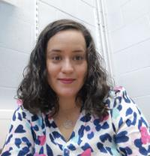
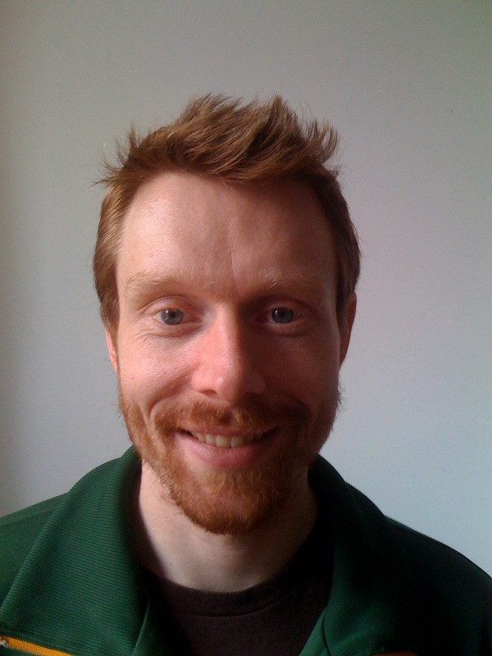
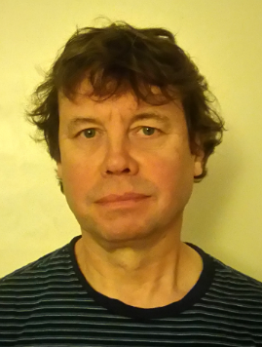

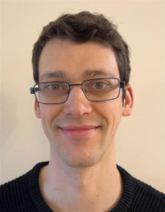
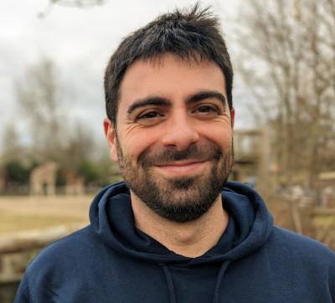


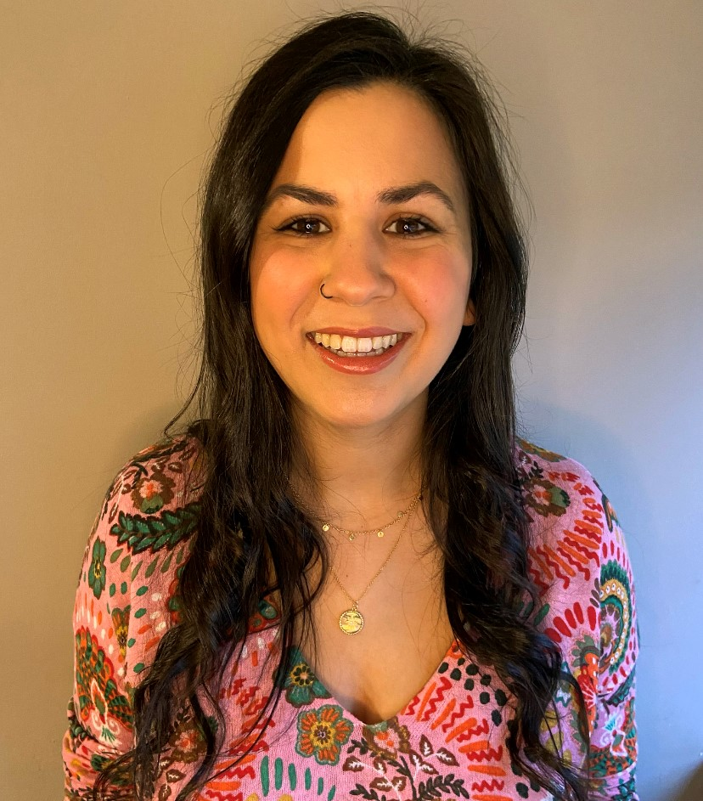
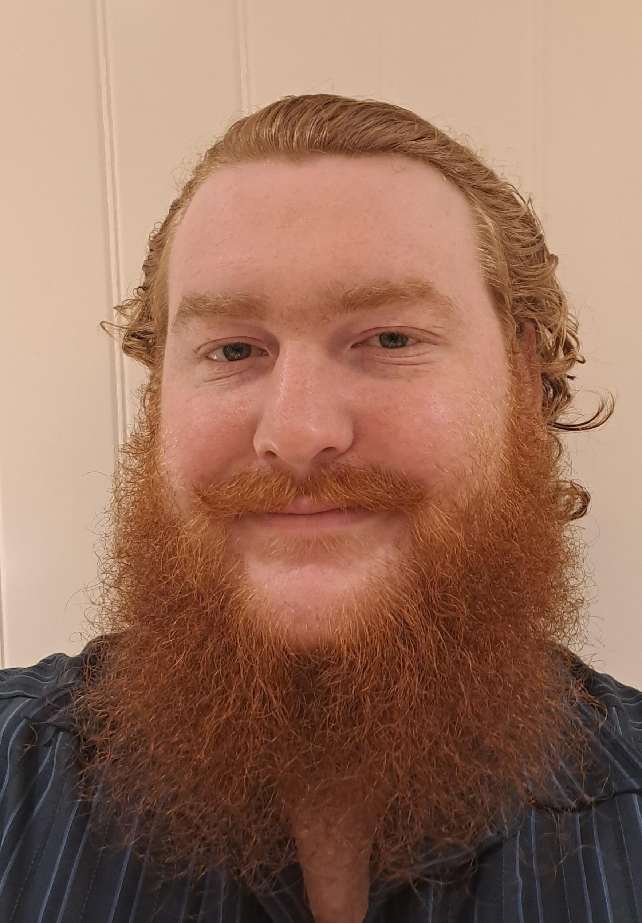


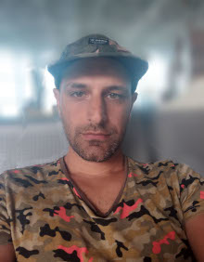
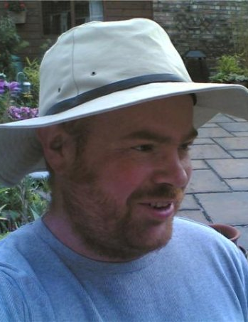
The CBF
Director
Director
Management
Associate directors
Dr Eva Caamano
Prof Andy Jones
Mr John Heap
Prof Dan Rigden
Dr Jamie Soul
Dr Francesco Del Carratore
Data Scientists
Software engineers
Dr Emily Johnson
Dr Anthony Evans
Dr Megan Hasoon
Dr Euan McDonnell
Dr Alex Rothwell
Dr Lauren Mee
Dr Shahram Mesdaghi
Dr Antony McCabe
Mr John Heap

